Slide 1



Predicting Injuries Based on Tornadic Magnitude
Presented by:
Matthew Baskette
Amie Costello
Merabu Nagwandala

Slide 2
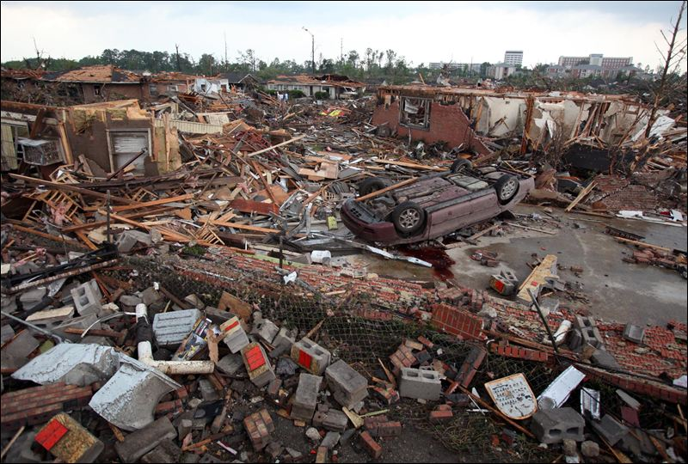

Can we predict the number of injuries based off the tornado dataset?
For our source, we used the US Tornado Dataset from Kaggle.com. This dataset has over 67,000 rows of tornado data in the United States from the years 1950 to 2021.

Slide 3
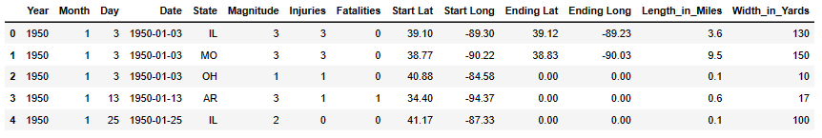

US Tornado Dataset 1950-2021
Prepare and Transform the data
Check Type of Data
Find and remove missing/null Data
Check for duplicates
Check for outliers
Deleting rows
Remove any columns that offer no value
Train and Scale the data

Slide 4

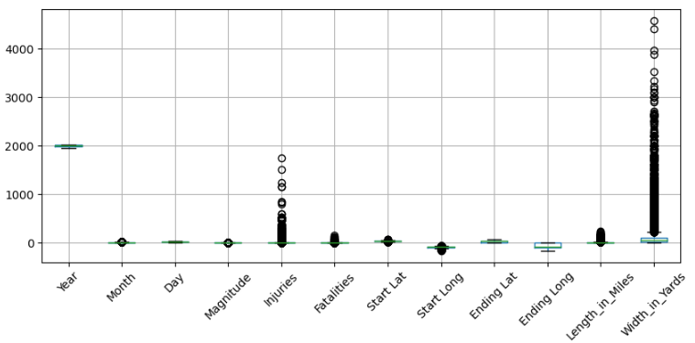
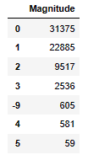
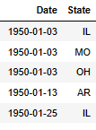
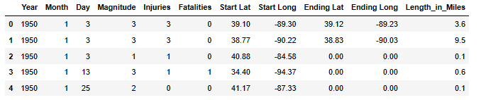


Outliers
Inaccurate Values
Redundant columns
Dataset after Transforming phase

Slide 5

MACHINE LEARNING MODELS
Can Injuries be predicted with the current dataset?
RANDOM FOREST REGRESSOR
Not enough data to accurately run a neural network machine learning model
MULTIPLE LINEAR REGRESSION
Ran and was the best model.
Accuracy = 55%
DECISION TREE REGRESSOR
Accuracy = 47%

Slide 6
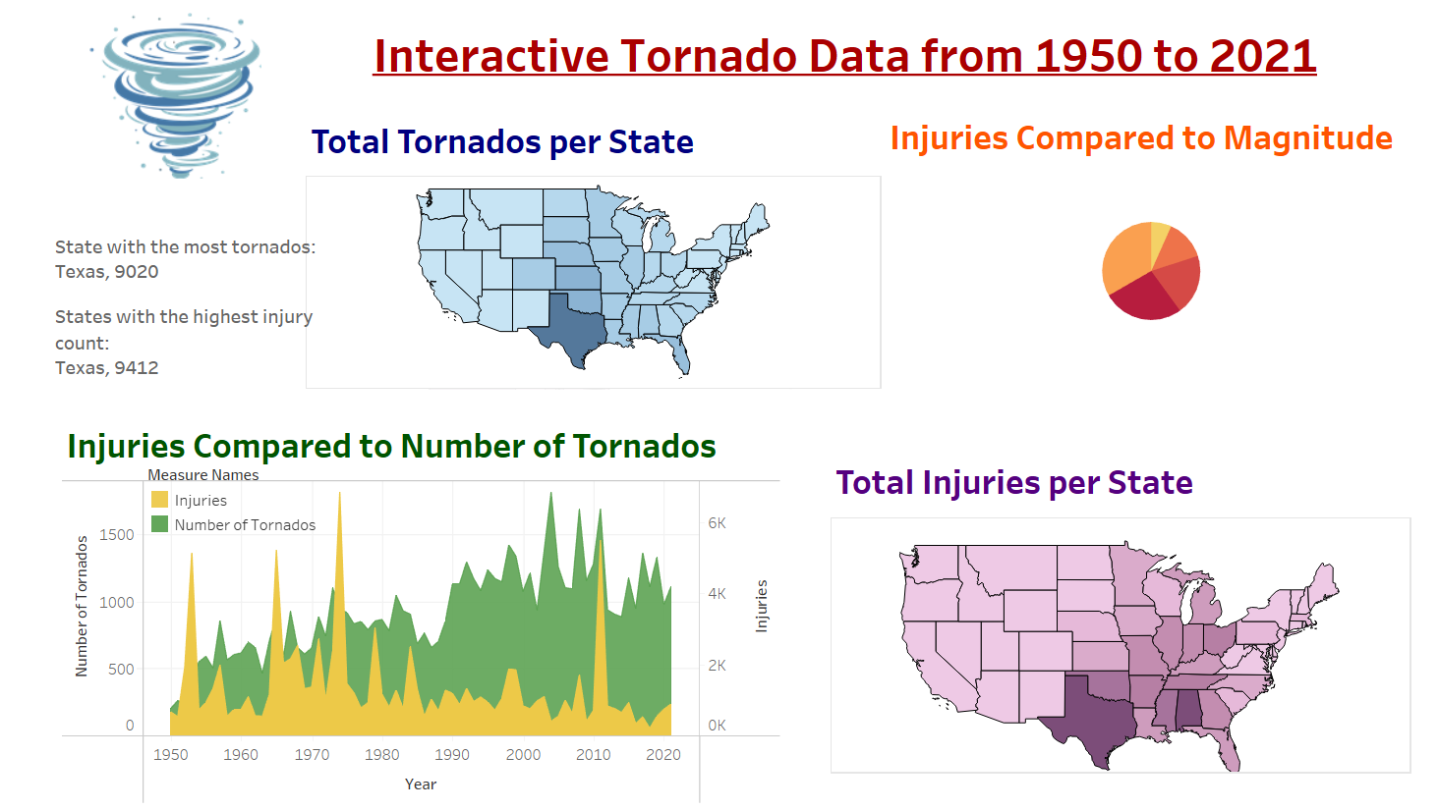

Hop over to Tableau for our interactive Tornado Data Dashboard

Slide 7
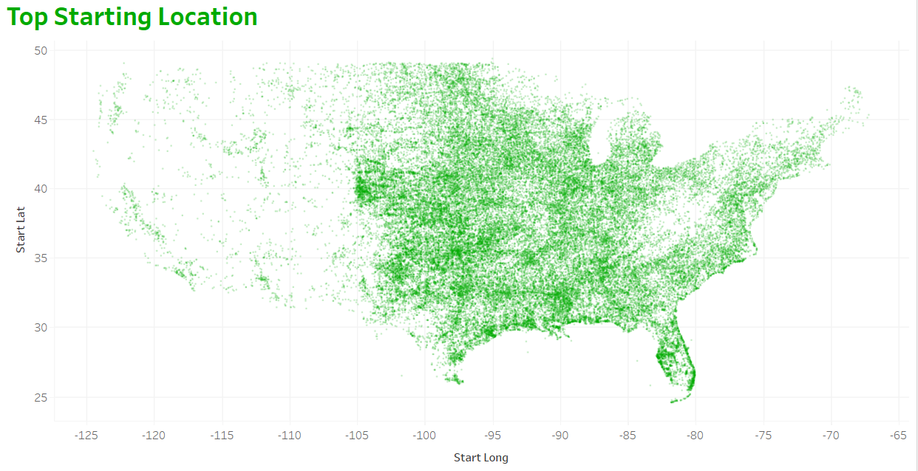
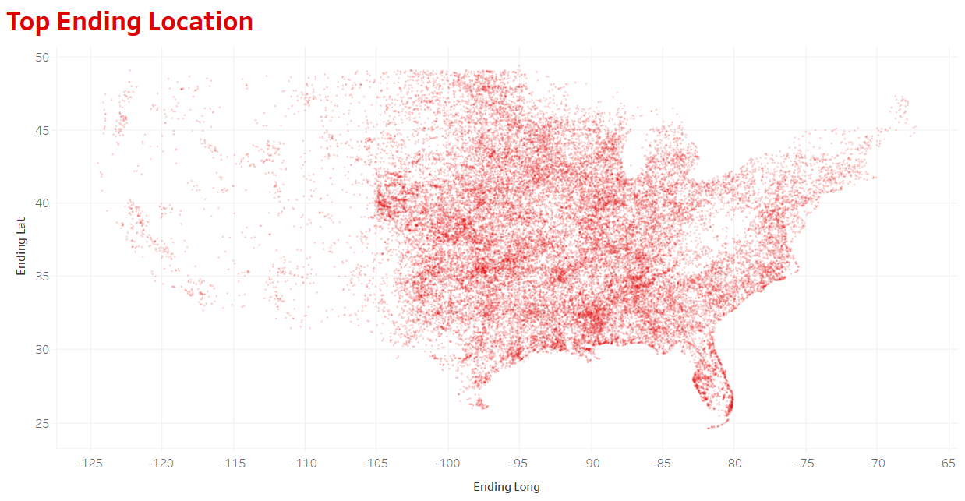
Top Tornado Starting and Ending Locations

Slide 8
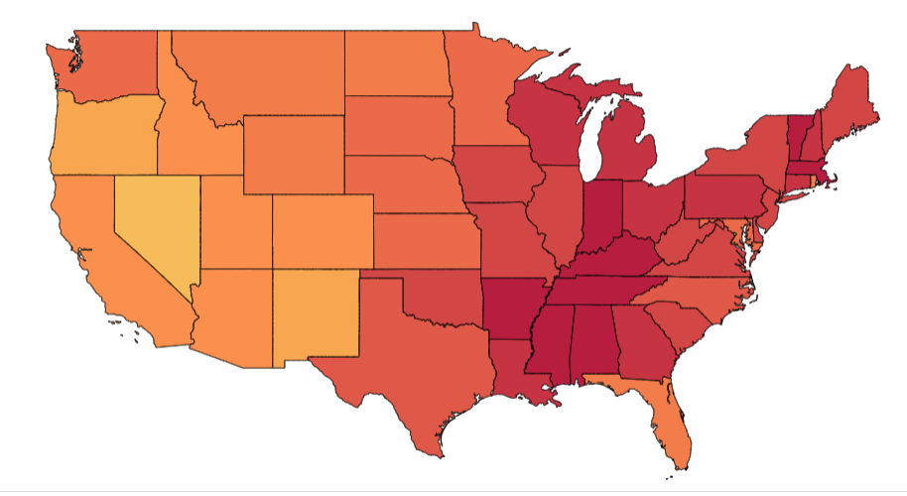
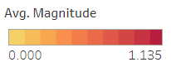
Average Magnitude per State

Slide 9
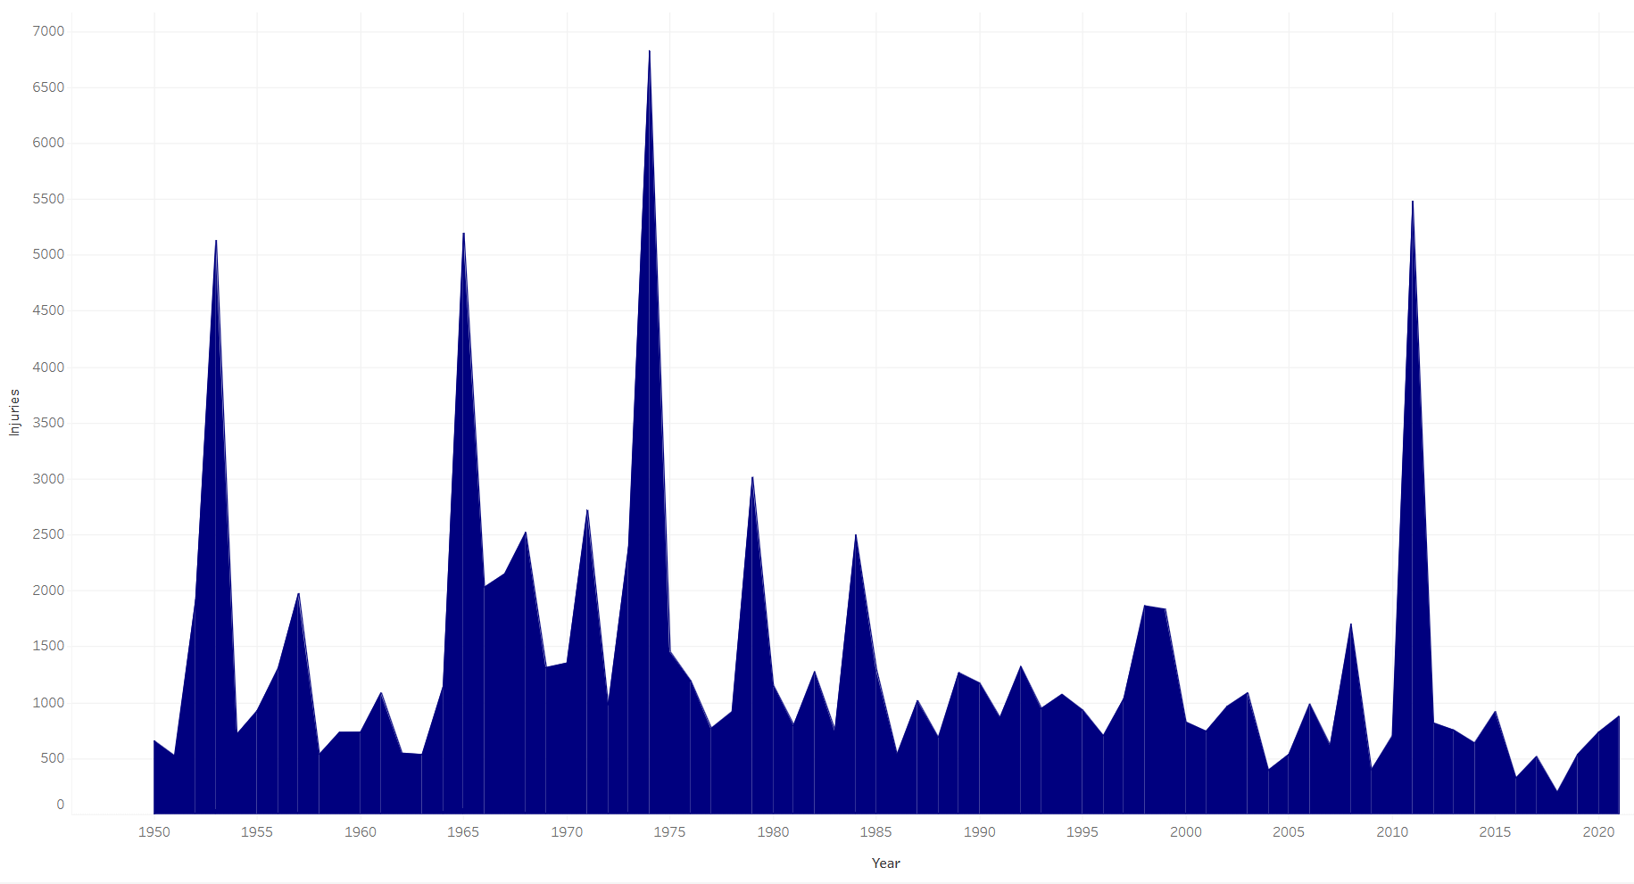
Total Injuries per Year
1950 to 2021

Slide 10

In conclusion …
The initial purpose of our project was to try and predict the number of injuries from our chosen dataset. Even though that was not accomplished, we discovered some very interesting things.
Our job as data analysts is to attempt every method available
to us to try and discover
something new.
“The core advantage of data is that it tells you something about the world that you didn’t know before”
—Hilary Mason, data scientist and founder, Fast Forward Labs.

Slide 11
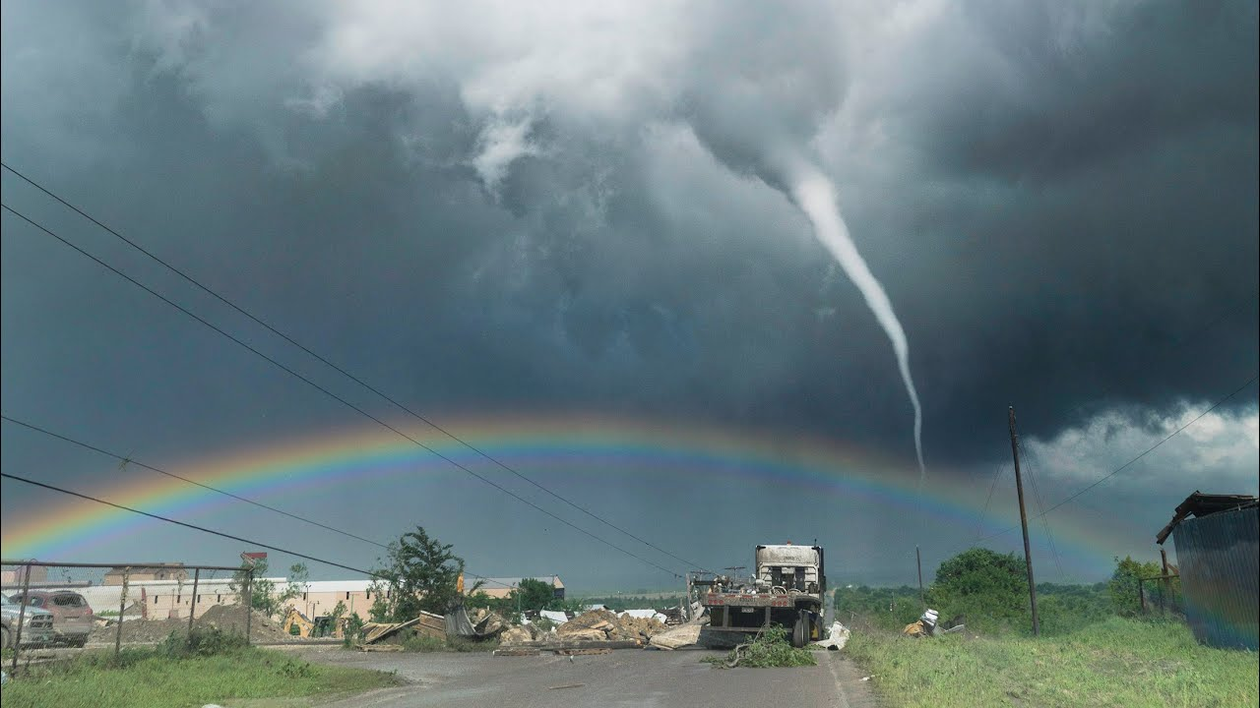
Any Questions ?
Presenters:
Matthew Baskette
Merabu Nagwandala
Amie Costello

